Slide 1
Claims Phase 7 Changes that impact stores What’s New, What’s Changed?
27 September 2017

Slide 2
New Features
The Build It logo is now on the landing page.
The Search screen now has the ability for you to select a date range.
New Claim Statuses:
Captured by DC
New Claim types have been introduced:
Build IT DC
These used to be ‘Supplier’ dropshipment claims where the supplier was the Build IT DC
Build IT DC Admin Claims
This used to be Admin Claims where the supplier was the Build IT DC

Slide 3
New Fields on the CMS Manage screen and the Claims Stats report
Uplift / DC Reference Number – this field that can be entered on a claim.
Authorised by Rep Indicator – this is a ‘Yes’/’No’ field that can be entered on a claim.
Outcome Reasons by DC – this is a standard list of reasons that the DC can assign to a claim e.g. Dc error, Store error.

Slide 4
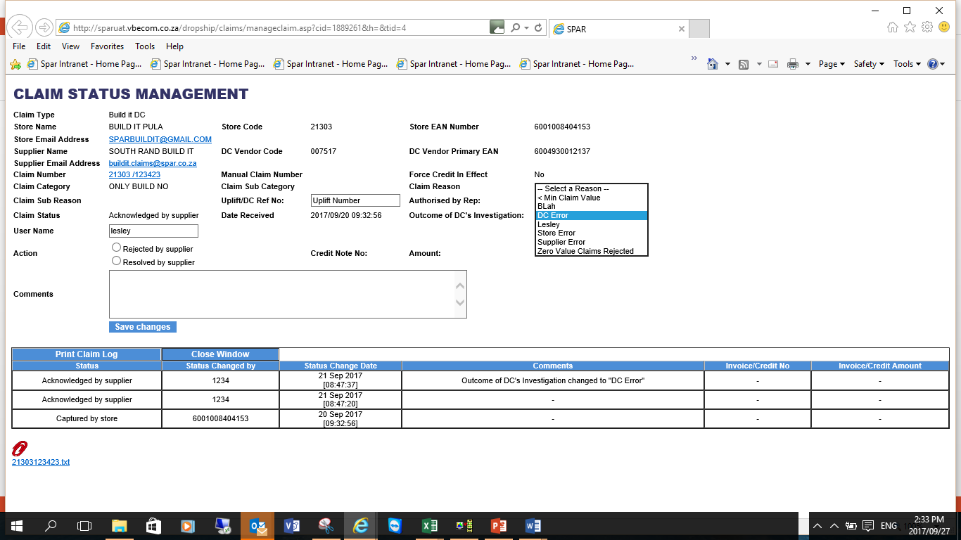
New Fields on CMS Manage screen

Slide 5
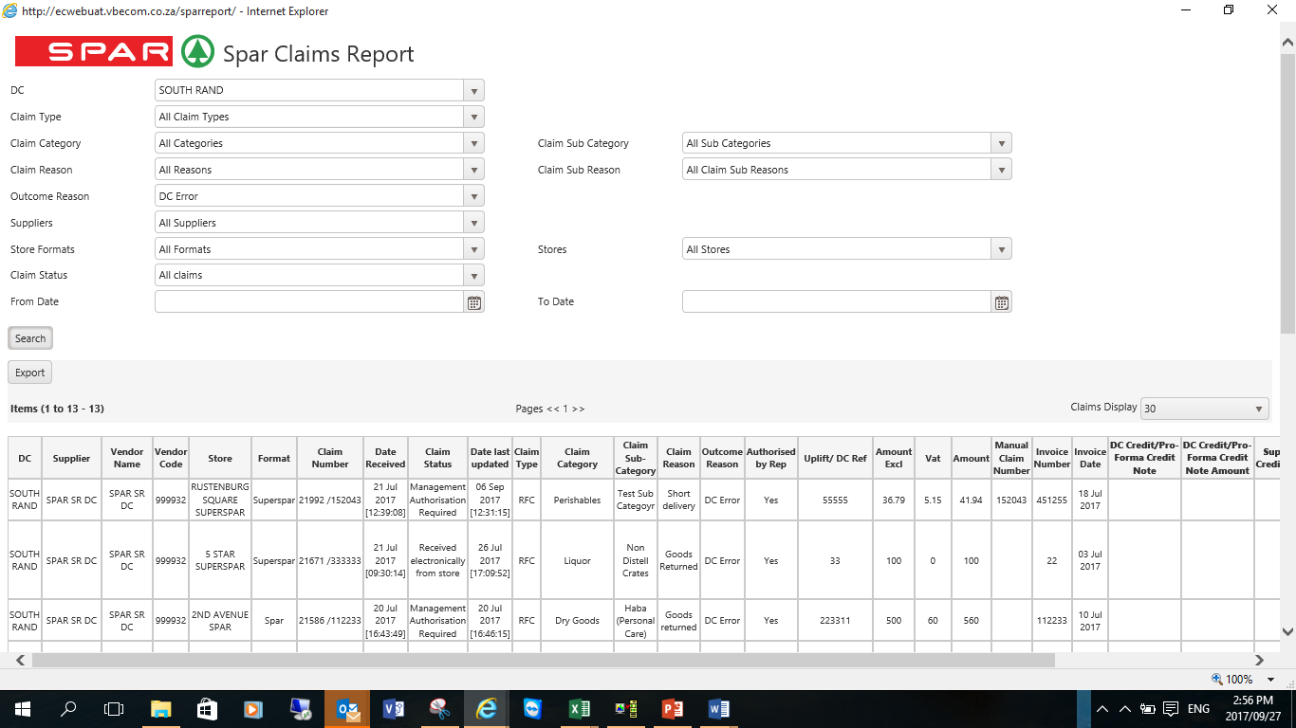
New Selection and Fields on Claims Stats report

Slide 6
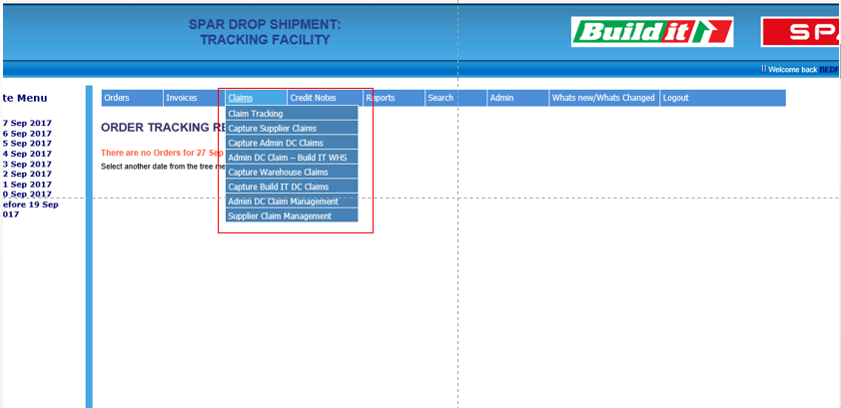
New Claim Capture Features
Store users must select the type of claim to be captured from the Claims Menu as shown on screen shot below.
Menu options shown will depend on the store format i.e. only Build It stores will be able to capture Build IT DC and Build It DC Admin Claims.

Slide 7
Build IT DC Admin Claims
These claims used to be ‘Admin DC Claims’ but the store used to have to select the Imports WHSE/Build IT DC as the Supplier.
Stores will no longer have to do this as the supplier will automatically be set to be the Build IT DC.
The type of claim is still ‘Admin DC Claim’.
These claims will be managed by the Build IT DC

Slide 8
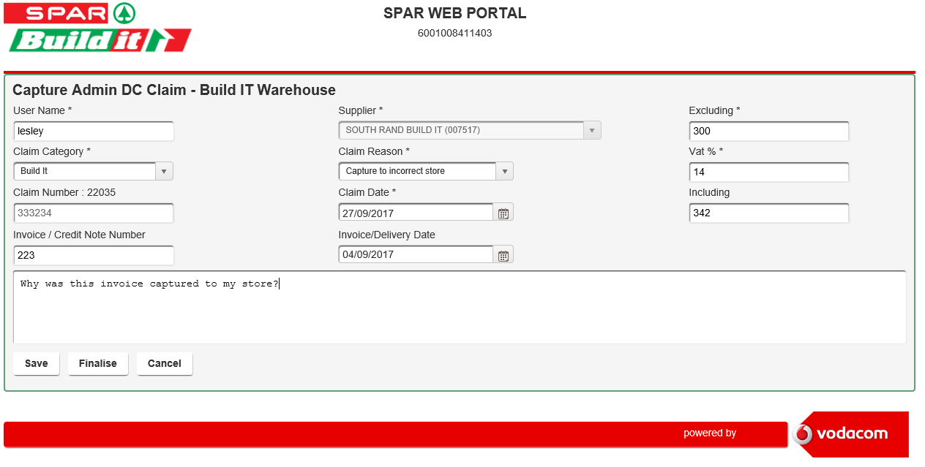
Build IT DC Admin Claims capture screen

Slide 9
Build IT DC Claims
These claims used to be ‘Supplier’ claims on the Build IT DC but have now been converted to be claim type ‘Build IT DC’
They will be managed by the Build IT DC

Slide 10
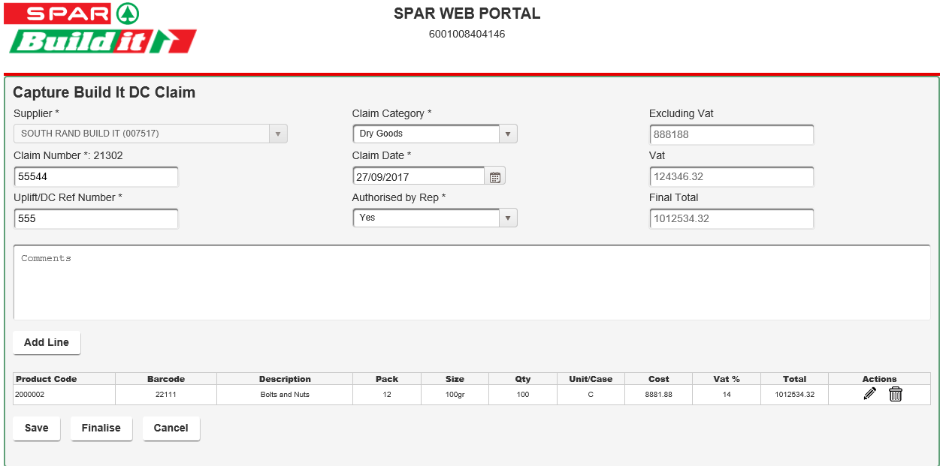
Build IT DC Claims Capture screen

Slide 11
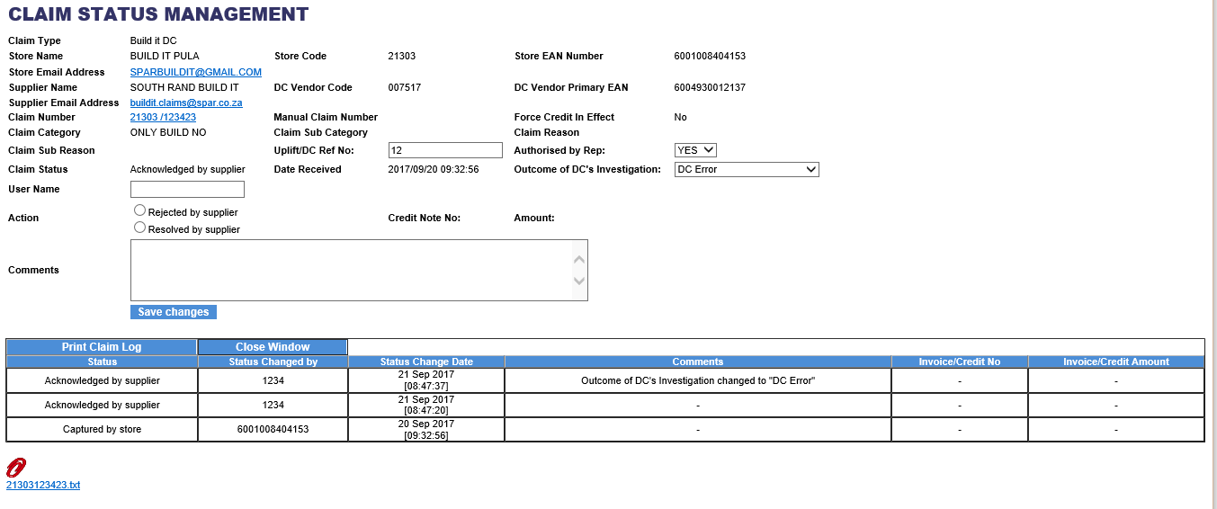
Build IT DC Manage screen
Text file that can be downloaded to Build IT’s claims system for validation; Click on hyperlink

